Slide 1
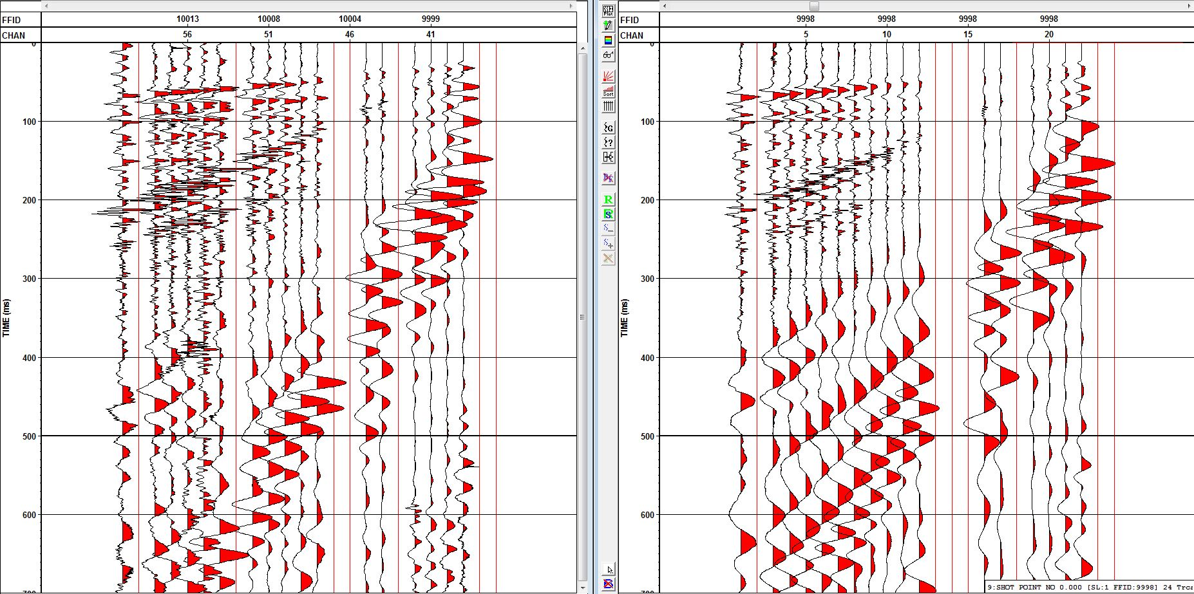
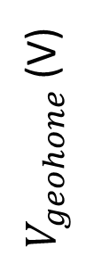
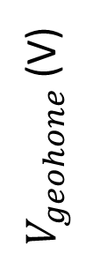
Traditional System
$V_{geohone}$(V)
Smart Dart Autonomous Deployment System
$V_{geohone}$(V)
0 100 200 300 400 500 600 700
Time (ms)

